Slide 1
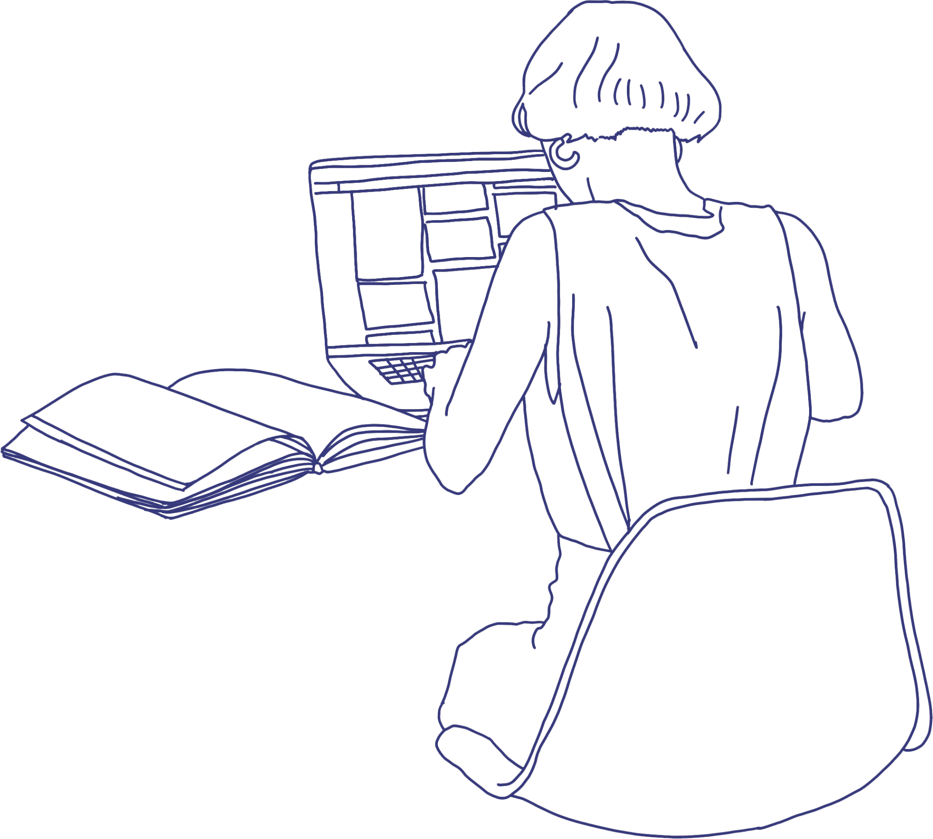

WELCOME
The secret lives of Open Source Designers.
Summary of diary studies of designers contributing to OSS
Eriol Fox they/them
https://github.com/sprblm/Diary-Studies-Designers-in-OSS

Slide 2

Superbloom is committed to changing who technology serves by leveraging design to shift power.
You may know us as Simply Secure, our former name.
https://github.com/sprblm/Diary-Studies-Designers-in-OSS
Notes:
Superbloom is a design and research nonprofit that is changing who technology serves. We do this by leveraging design to shift power in the tech ecosystem. You may know us as Simply Secure.

Slide 3
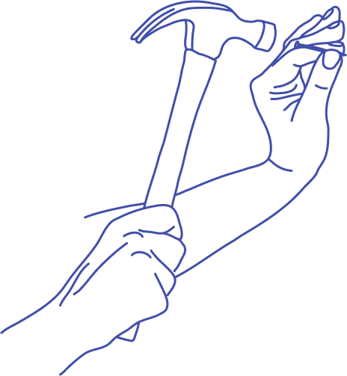

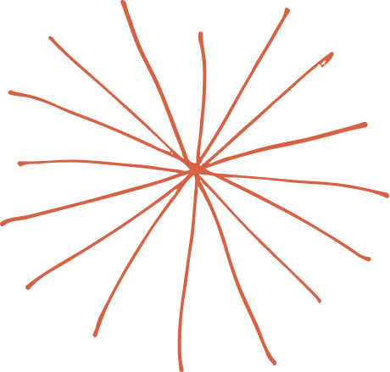



Some of our projects
Deceptive Design: Moving Towards Trusted Design Patterns -
https://techlab.webfoundation.org/deceptive-design/overview
“User Testing can Be Fun” - a set of visual and interactive resources on user testing for open source developers - https://sprblm.github.io/devs-guide-to/
USER - Sloan Foundation grant to study usability practices in open source scientific software projects - https://user-project.superbloom.design/
Building Blocks - a toolkit for funders to better understand and support critical infrastructure projects - https://buildingblocks.simplysecure.org/
https://github.com/sprblm/Diary-Studies-Designers-in-OSS
Notes:
Creating open resources is at the heart of what we do. Human-centered design methods allow us to co-design tools and processes alongside the communities that will use and benefit from them.
Partnering with Internews and OKThanks, we created a set of visual and interactive resources on user testing for open source developers.
Continuing to promote developer/designer collaboration, we we were lucky to receive a grant from the Sloan Foundation to study how scientific open source software projects think about their users, work with designers, and prioritize usability.
And earlier this year, we launched Building Blocks, a toolkit for funders to better understand and support critical digital infrastructure projects to promote sustainability

Slide 4

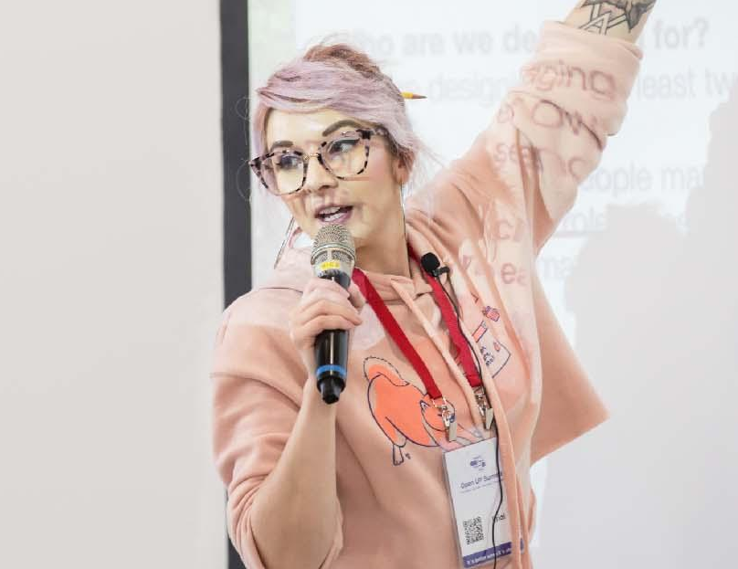
Hi, I’m Eriol. (Ehh-roll).
They/Them pronouns.
12+ years in digital product design and UX.
5-6 years in open source software (OSS).
1.5 years at Superbloom.
PhD (@Newcastle) researching how design is done and how designers are involved in Humanitarian & Human Rights OSS.
senior designer and researcher
eriol fox
@erioldoesdesign
eriol@superbloom.design
https://github.com/sprblm/Diary-Studies-Designers-in-OSS

Slide 5

In 2022, Vermont Complex Systems Center at The University of Vermont awarded Superbloom an OCEAN grant (Open-Source Ecosystems and Networks Research Awards program) to investigate and give designers (who are currently contributing to OSS) an opportunity to describe their experiences in a safe environment and through anonymous, privacy respecting means.
A
B
O
U
T
T
H
E
D
E
S
I
G
N
E
R
D
I
A
R
Y
S
T
U
D
y
https://github.com/sprblm/Diary-Studies-Designers-in-OSS
Notes:
In 2022, Vermont Complex Systems Center at The University of Vermont awarded Superbloom an OCEAN grant (Open-Source Ecosystems and Networks Research Awards program) to investigate and give designers (who are currently contributing to OSS) an opportunity to describe their experiences in a safe environment and through anonymous, privacy respecting means.

Slide 6
Participant ID | Part Time / Full Time | Employment Status (Contract, Staff, Self-employed, etc) | Student (postgraduate) | OSS Projects contributed to
Grey | FT | Self-employed | No | 2-3
Pink | PT | Contract | Yes | 3
Yellow | FT | Staff | No | 3-5
Green | FT | Self-Employed Contracts | No | 4-6
Blue | FT | Staff | Yes | 2-3
https://github.com/sprblm/Diary-Studies-Designers-in-OSS
Notes:
In this short talk, we'll give an overview of our findings but specifically zoom in on the ways in which Scientific and Research OSS (S&R OSS) contributors/teams leverage community spaces, interactions and documents to make user-informed choices about how to make their documentation and tools better. There will then be a critical review of how design research trained individuals might iterate and improve on these practices to make usability and design even better in S&R OSS.

Slide 7
Find out about:
How these designers first become involved in OSS.
How designers decide to contribute to an OSS project.
What tools designers use when contributing to OSS.
What artifacts were shared across the sixteen weeks.
In the longer findings document: https://github.com/sprblm/Diary-Studies-Designers-in-OSS
https://github.com/sprblm/Diary-Studies-Designers-in-OSS

Slide 8
Designer-developer collaboration
Conversely, developers were more involved in the design process, with designers “Getting responses from developers about design proposals”.
All designer participants mentioned getting feedback from the developers as a crucial step in their process.
https://github.com/sprblm/Diary-Studies-Designers-in-OSS

Slide 9
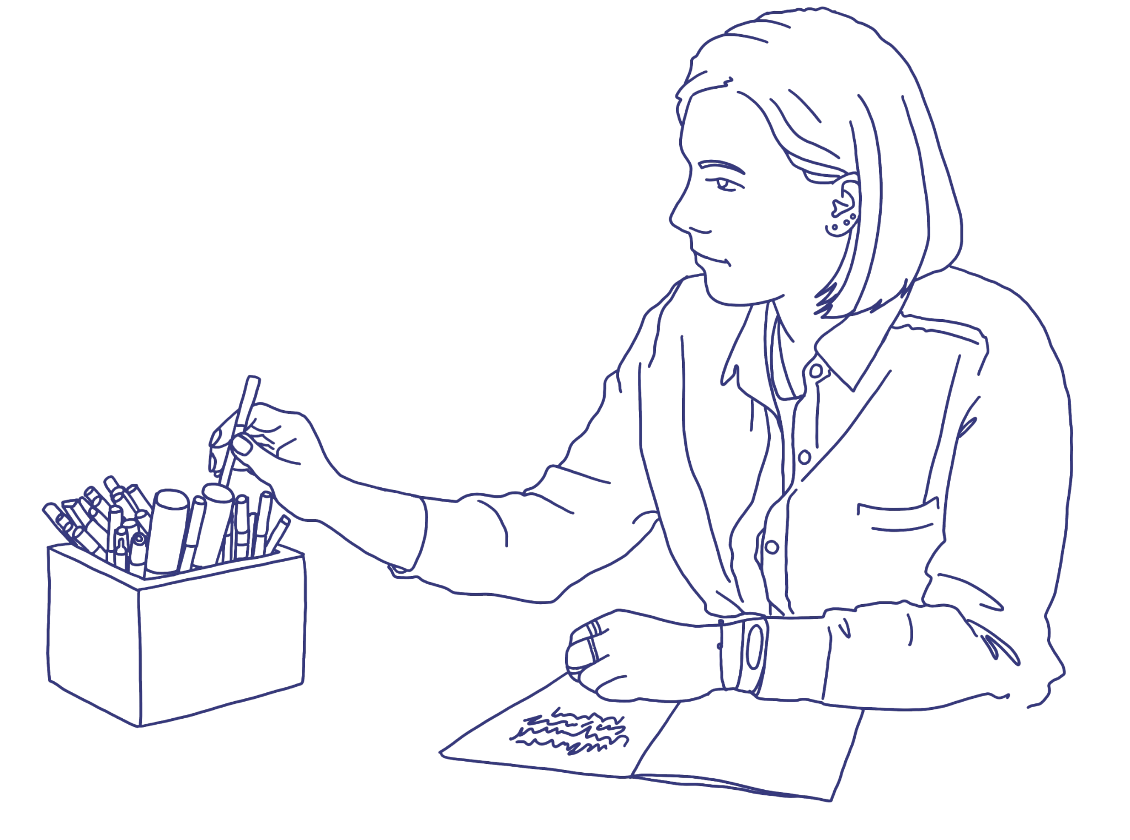
“(I) made a user-flow diagram to make my designs more comprehensible”.
“A developer found my organized Figma files useful”.
https://github.com/sprblm/Diary-Studies-Designers-in-OSS

Slide 10
Openness practices
The motivations for being open seem to follow some general themes. Designer participants who share their assets and resources do so for easier collaboration with stakeholders.
Another motivation for sharing assets was to have more involvement from the community, as one participant “shared the doc with the team at (OSS community organization) for other designers to make inputs”.
https://github.com/sprblm/Diary-Studies-Designers-in-OSS

Slide 11
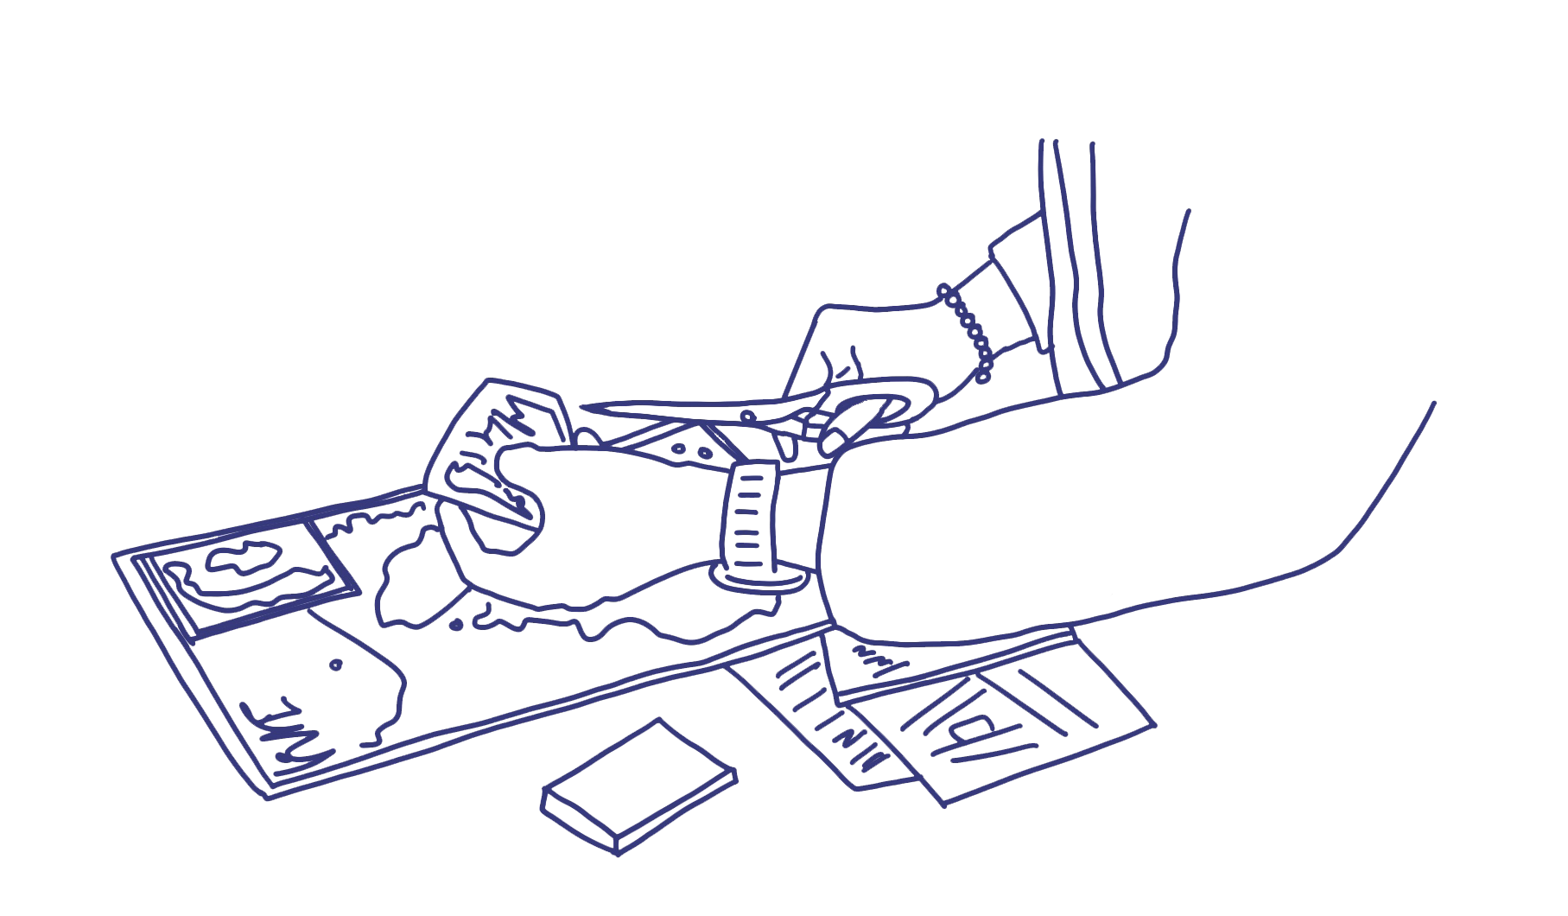
“I heard back from someone I shared open design resources with that it was helpful and that they will be using our contributions”.
https://github.com/sprblm/Diary-Studies-Designers-in-OSS

Slide 12
Designers speaking about success
Success via feedback
Success via completion of design and/or "live release"
Success via knowing what is a priority for the OSS
Success via attracting more designers to the OSS
Success via acknowledgement, inclusion and collaboration
Success via accessibility and usability
https://github.com/sprblm/Diary-Studies-Designers-in-OSS

Slide 13
D
E
S
I
G
N
E
R
S
S
P
E
A
K
I
N
G
A
B
O
U
T
S
U
C
C
E
S
s
Success via feedback
The designers saw their work as successful when the feedback they received as relevant and useful.
Designers tend to assume “they’ve got it right” (i.e. are successful) if there are no questions or feedback on their design work. This was less so if the designer did not seem particularly confident about their proposed design.
Participants also viewed “slow” feedback negatively – the lack of communication was seen as a progress blocker.
https://github.com/sprblm/Diary-Studies-Designers-in-OSS

Slide 14
“When I get feedback on what's wrong in my design and get next steps that are actionable”.
“There was a delay in feedback from my prior conversations with the maintainer, and I was unable to kick off immediately”
https://github.com/sprblm/Diary-Studies-Designers-in-OSS

Slide 15
Designers speaking about success
Success via feedback
Success via completion of design and/or "live release"
Success via knowing what is a priority for the OSS
Success via attracting more designers to the OSS
Success via acknowledgement, inclusion and collaboration
Success via accessibility and usability
https://github.com/sprblm/Diary-Studies-Designers-in-OSS

Slide 16
D
E
S
I
G
N
E
R
S
S
P
E
A
K
I
N
G
A
B
O
U
T
S
U
C
C
E
S
s
Success via knowing what is a priority for the OSS
Measuring progress on priorities was difficult and one designer spoke consistently of the need for a product or project manager to guide them to the highest priority task.
Designers employed a lot of tactics in order to better understand priorities in the absence of a documented roadmap or plan for the OSS, or when the OSS plan exists in a single mind or collective of OSS community members' minds.
Designers commented that there were “no clear roadmaps for implementation” of the OSS and that while issues and meetings presented a pathway, these were not always coherent or indicative of any wider objectives.
https://github.com/sprblm/Diary-Studies-Designers-in-OSS

Slide 17
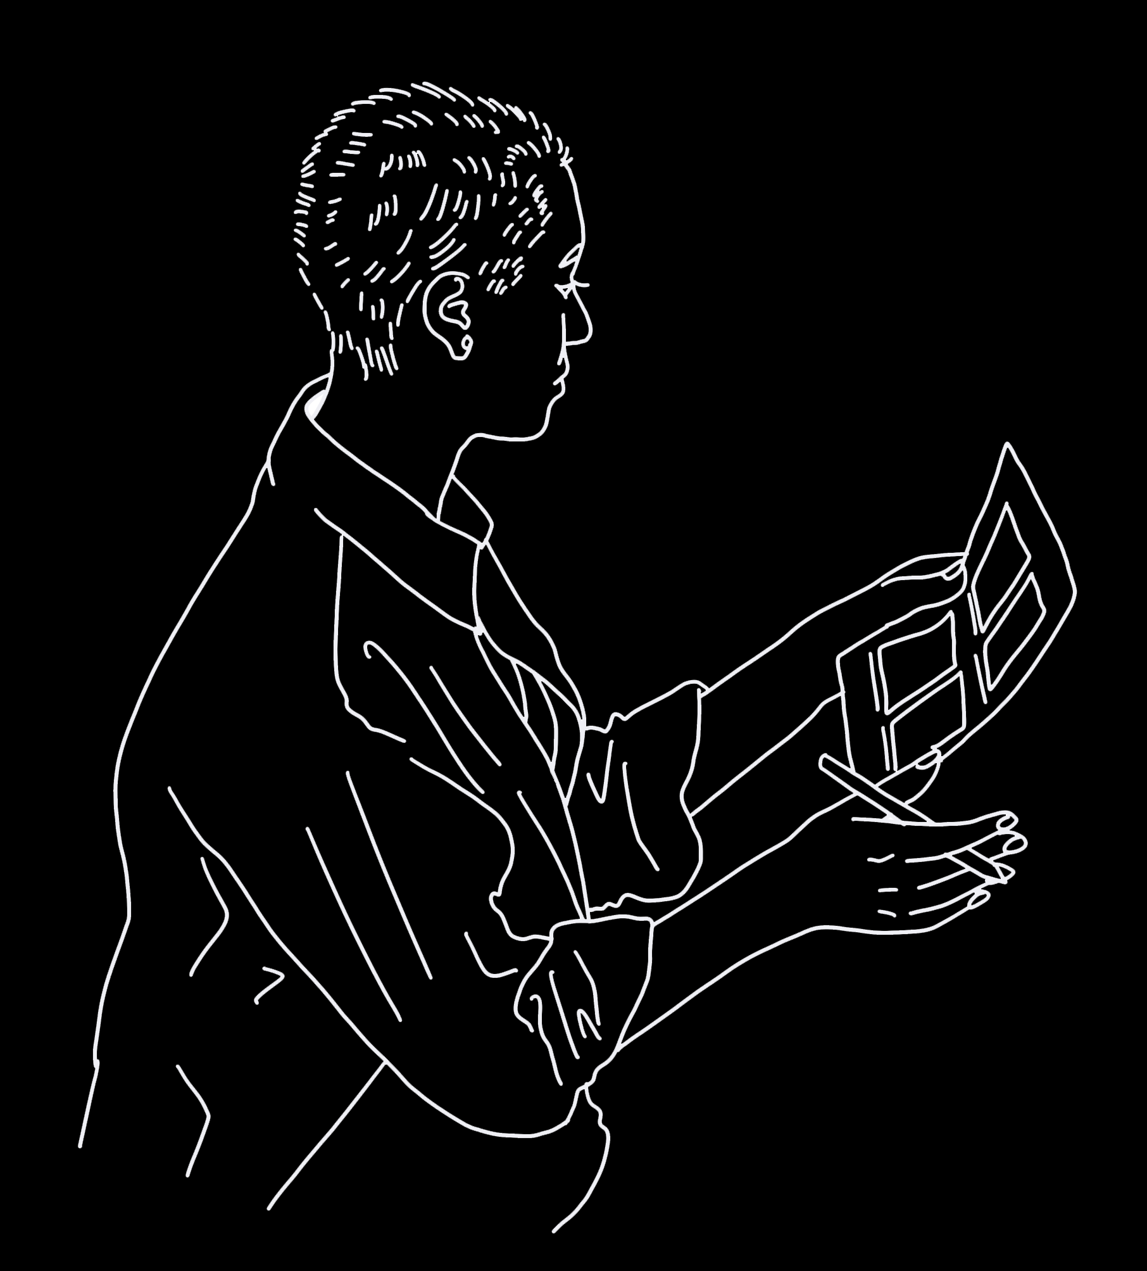
“Not much of a hack, but I've started to get important stakeholders (often project leads) to sketch out their ideas more so that I know what they're thinking”.
https://github.com/sprblm/Diary-Studies-Designers-in-OSS
Notes:
Onboarding in particular is a responsibility that is passed off to communities of users. For instance, the burden of teaching a tool is often on professors, researchers, or students to teach each other. Tool feedback and troubleshooting – key components of user research – happens organically in user community channels such as Slack, Discourse, community calls, etc. Projects teams that are active and responsive in user channels are participating in informal user research, whether they recognize these user research methods or not.

Slide 18
What might make designers leave an OSS project?
The designers of the diary study had many challenges, mostly centering around communications, delegation, project/product management and the value of their work compared to time invested by them.
Designers often expressed disappointment when all of their time was spent on annotating specific details of a design artifact or document (e.g. This button in a UI does X, this usability study means that we know X about users etc.) or justifying why design should be done in the OSS.
https://github.com/sprblm/Diary-Studies-Designers-in-OSS

Slide 19
Designers want seven things to be present before they leave an OSS project:
S
U
C
C
E
S
S
I
O
N
P
L
A
N
N
I
N
G
D
E
S
I
G
N
The design work is done and continues to be done in open design software (so not proprietary closed software such as Adobe). However, these open source design tools are stated as "not as good as closed tools.
The design is left in a way that other people can pick up and understand.
To leave the OSS in "a better place" in terms of design (this would be unique and specific to each OSS).
To ensure that the OSS maintainers know how and what was done and the project is handed over slowly and carefully. Do not “ghost" and help knowledge be sustained
https://github.com/sprblm/Diary-Studies-Designers-in-OSS
Notes:
What are the experiences that designers contributing to OSS commonly have?
What are the conditions that can set designers up for success within OSS projects, specifically regarding "contributions of design"?
What conditions create a sense of inclusion, both at the project and community scales, for designers in OSS?
What is a design contribution and how is human centered design understood within OSS communities?
How do designers and OSS project developers/maintainers/communities describe "successful" design contributions?
How do designers describe a "successful" relationship with OSS project developers/maintainers/communities around their OSS project?

Slide 20
Designers want seven things to be present before they leave an OSS project:
S
U
C
C
E
S
S
I
O
N
P
L
A
N
N
I
N
G
D
E
S
I
G
N
To know the design will change after you"ve gone. OSS is about sharing and being willing to accept changes
To plan the structure for the OSS to not just recognise design contributions but document them well too
To inspire designers to get involved in the OSS
Most designers expressed a desire to never fully leave an OSS project and they would ideally stay on in an advisor role and be able to answer questions when needed. For many, participation in OSS was an ethical or socially motivated reason.
https://github.com/sprblm/Diary-Studies-Designers-in-OSS
Notes:
What are the experiences that designers contributing to OSS commonly have?
What are the conditions that can set designers up for success within OSS projects, specifically regarding "contributions of design"?
What conditions create a sense of inclusion, both at the project and community scales, for designers in OSS?
What is a design contribution and how is human centered design understood within OSS communities?
How do designers and OSS project developers/maintainers/communities describe "successful" design contributions?
How do designers describe a "successful" relationship with OSS project developers/maintainers/communities around their OSS project?

Slide 21
Emergent Recommendations
As an OSS project interested in receiving design contributions, review and take note of the ways in which designers decide whether to offer design to an OSS project. Some of these indicators for designers include ‘ Is the project clear what problems they want solved by the designer?’ and ‘Is this OSS a one-person project and is it still active?’
See ‘How do designers decide whether they’d like to contribute to or work on an OSS project? ‘ section.
See more recommendations in the findings document: https://github.com/sprblm/Diary-Studies-Designers-in-OSS
https://github.com/sprblm/Diary-Studies-Designers-in-OSS

Slide 22
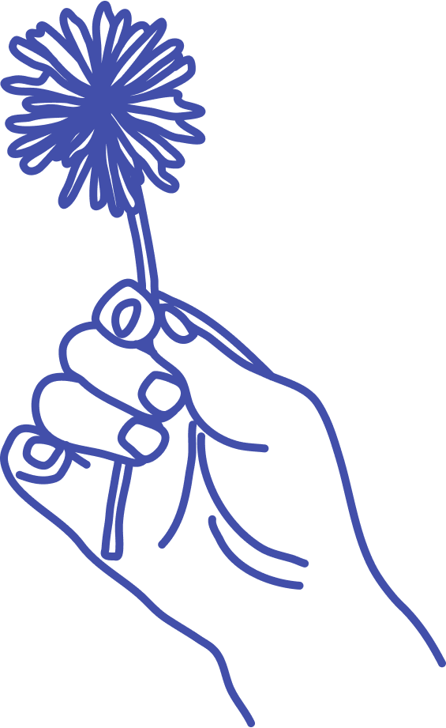
Thank you!
github.com/sprblm/Diary-Studies-Designers-in-OSS
We’re looking to fund this research again and invite more designers to participate.
If you’d like to participate please get in contact.
Get in touch
Presentation made in google slides
Illustrations made using procreate on ipad
and adobe illustrator saving as .svg.
Open Fonts used:JetBrains & IBM Plex Mono
@superbloom
contact@superbloom.design
superbloom.design
https://github.com/sprblm/Diary-Studies-Designers-in-OSS

